Slide 1
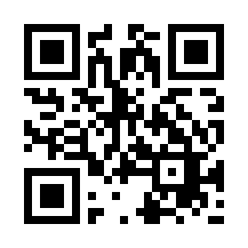

Software Project
https://bit.ly/3dKTBm2

